Slide 1

Queen Elizabeth’s Grammar School
Faversham
Year 6 to 7 Student
Transition Profile
Name:

Slide 2


Dear Student,
Welcome to Queen Elizabeth’s School!
This transition profile is designed to help you settle into Queen Elizabeth’s and enable your Form Tutor and others in the class to know a little bit about you as a person.
We have also included a few little tasks for you to do across some of the subjects that will be on your timetable in Year 7. This will hopefully give you an idea of the types of topics you will study.
Once you have completed the tasks, you will have a couple of basic instructions on what to do next. To earn yourself your first achievement house point, e-mail this back to school by the start of term in September!
Good luck and have fun learning about the new exciting things you will doing at secondary school.

Slide 3

This section is all about you!
Please use this and the next page to let us know your likes, dislikes, hobbies, favourite foods, favourite music etc.
Don’t forget to include a picture!
Your form tutor will use this information in form time to help you get to know your new classmates and vice versa.
Please feel free to be creative and create whatever page you like.

Slide 4


Slide 5
English
We are looking forward to welcoming you to the English department in September. In preparation, you should read the copies of the first two chapters of The Odyssey given to you with your welcome letter and then answer the questions that follow:
Do some research into one of the following myths. What are they about?
- Theseus and the minotaur
- Achilles and the trojan war
- Hercules
Why are they considered an archetypal hero? (Archetypal means the perfect example of)
Who is your hero and why?

Slide 6
English Task

Slide 7
Mathematics
These times tables are a mystery. Each digit has been replaced by a letter and the order of the times tables has been jumbled up! Can you work out which digit each letter stands for? There are two sets of times tables for you to complete. Try to spot patterns in the digits so you can rule out certain numbers and rule in others. Can you work out which times table is the 11 times table or the 1 times table? Does the number of single digit answers help you work out which times table it could be? Solve the puzzle and record which digit each letter stands for below.
D x A = A H x A = EJ
C x A = EC E x A = JE
DB x A = AB J x A = DJ
K x A = GB DJ x A = HJ
F x A = KE A x A = GA
G x A = DC DD x A = AA
A = …………….. B = …………….. C = …………….. D = ……………..
E = …………….. F = …………….. G = …………….. H = ……………..
J = …………….. K = ……………..

Slide 8
Science
Do you know your zodiac birth sign?
If not find out and then find where your constellation is in the night sky.
Draw a picture of their arrangement and write a short piece about the stars that make up your constellation, maybe there is a story from history or a legend to go with it.

Slide 9
Music
Please describe your experiences of playing an instrument or singing in the space below.

Slide 10
Languages
Bonjour! Hallo! Hola!
Are you are going away this summer to a non-English country? If the answer is ‘yes’ we would like you to find out and use some phrases whilst you are away.
If the answer is ‘no’, we would like you to think of a country you would like to visit and find some phrases that would help you if you were to go there.
Write the phrases that you used below and what they mean. What reaction did you get from the locals when you spoke in their language?

Slide 11
Geography
Are you planning on going somewhere other than Kent for your summer holidays? Are you planning on visiting relatives in a different county? If so, we expect the landscape, climate or culture of that country or county to be different.
Your task is to design a poster to advertise why it would be worthwhile visiting that place and what they would expect to see.

Slide 12
History
The Science Museum wants to create an exhibition which tells us about life in the early twenty-first century. Choose an item and write down your reasoning for why your item should be included in the museum exhibition. You can use these sentence starters to help you if you wish:
Useful starter sentences:
‘The item which should be chosen is …’ ‘It tells us a great deal about …’ ‘In addition, it reveals how …’ ‘The problem with items like … is that ….’

Slide 13

And finally……………
What are you expecting when you arrive in September?
Have you any worries or concerns?
What are you looking forward to the most about starting at your new school?
Use this last blank page let us know some of your feelings. We expect that your concerns and worries are exactly the same as other students going to Queen Elizabeth’s for the first time.
Don’t worry as we are here to help you on your first day!

Slide 14
Arriving in September….

Slide 15
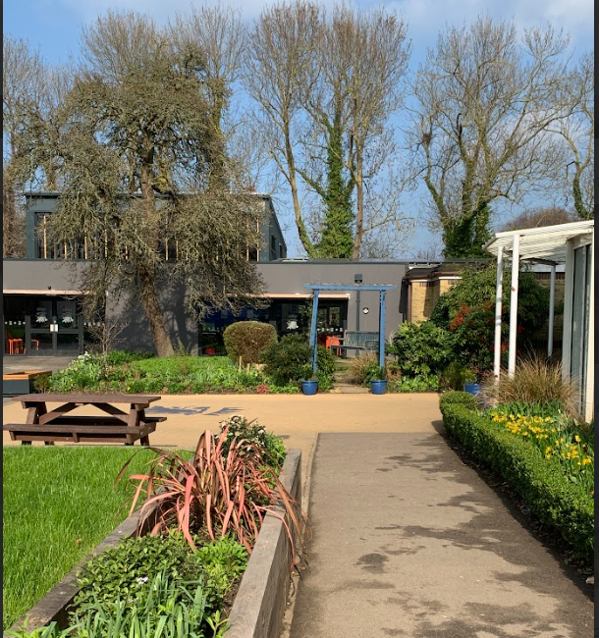
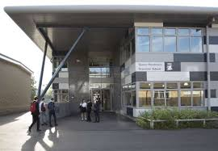
What Now?
Well done! You have finished!
We hope you have enjoyed doing a little bit of work and research into some of the subjects you will be studying at Queen Elizabeth’s and that it has given you an insight, into the fun and interesting things you will be learning.
To allow your form tutor to use this in form time, it now needs emailing to Queen Elizabeth’s. Please can you follow the instructions below:
Save the document as a pdf file and name it
QE Transition Portfolio – (Insert your full name and new Form) i.e. Sam Smith 7S
Email the document to KS3 Administrator:
year6-portfolio@queenelizabeths.kent.sch.uk
We’re looking forward to seeing you in September!

